Slide 1

HITS Algorithm
CS583, Bing Liu, UIC

Slide 2
The HITS algorithm: Grab pages
Given a broad search query, q, HITS collects a set of pages as follows:
  It sends the query q to a search engine.
  It then collects t (t = 200 is used in the HITS paper) highest ranked pages. This set is called the root set W.
  It then grows W by including any page pointed to by a page in W and any page that points to a page in W. This gives a larger set S, base set.
CS583, Bing Liu, UIC

Slide 3
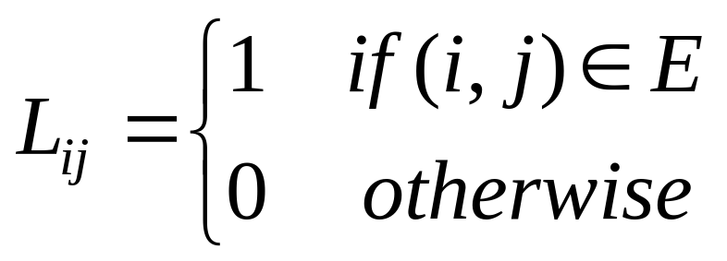
The link graph G
HITS works on the pages in S, and assigns every page in S an authority score and a hub score.
Let the number of pages in S be n.
We again use G = (V, E) to denote the hyperlink graph of S.
We use L to denote the adjacency matrix of the graph.
CS583, Bing Liu, UIC

Slide 4
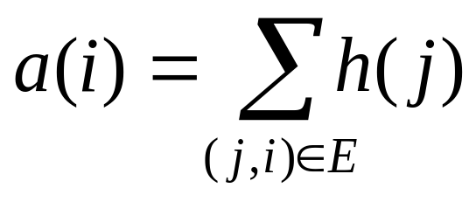
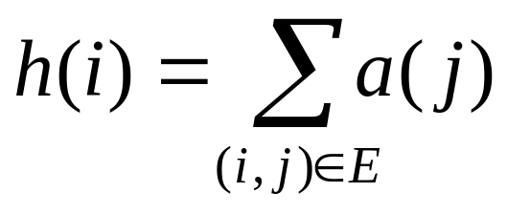
The HITS algorithm
Let the authority score of the page i be a(i), and the hub score of page i be h(i).
The mutual reinforcing relationship of the two scores is represented as follows:
(31)
(32)
CS583, Bing Liu, UIC

Slide 5
HITS in matrix form
We use a to denote the column vector with all the authority scores,
a = (a(1), a(2), …, a(n))^{T}, and
use h to denote the column vector with all the authority scores,
h = (h(1), h(2), …, h(n))^{T},
Then,
a = L^{T}h
h = La
(33)
(34)
CS583, Bing Liu, UIC

Slide 6
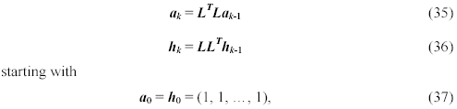
Computation of HITS
The computation of authority scores and hub scores is the same as the computation of the PageRank scores, using power iteration.
If we use a_{k} and h_{k} to denote authority and hub vectors at the kth iteration, the iterations for generating the final solutions are
CS583, Bing Liu, UIC

Slide 7
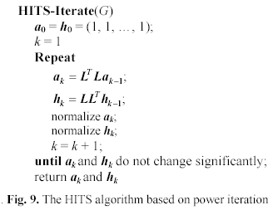
The algorithm
CS583, Bing Liu, UIC

Slide 8
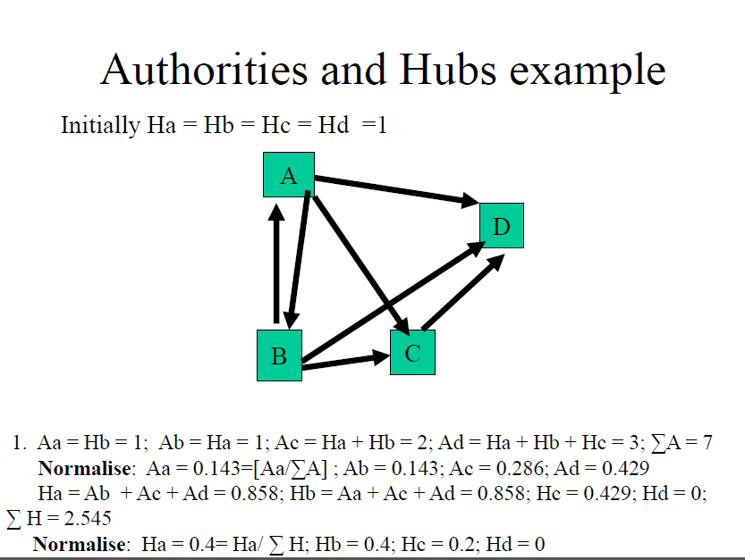
CS583, Bing Liu, UIC

Slide 9
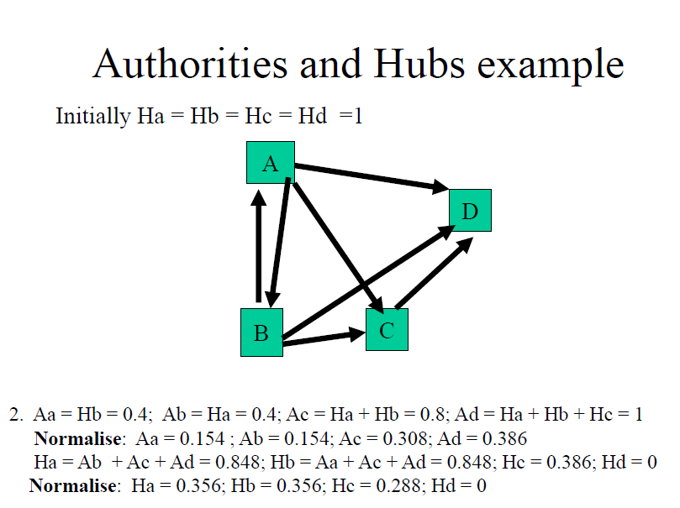
CS583, Bing Liu, UIC

Slide 10
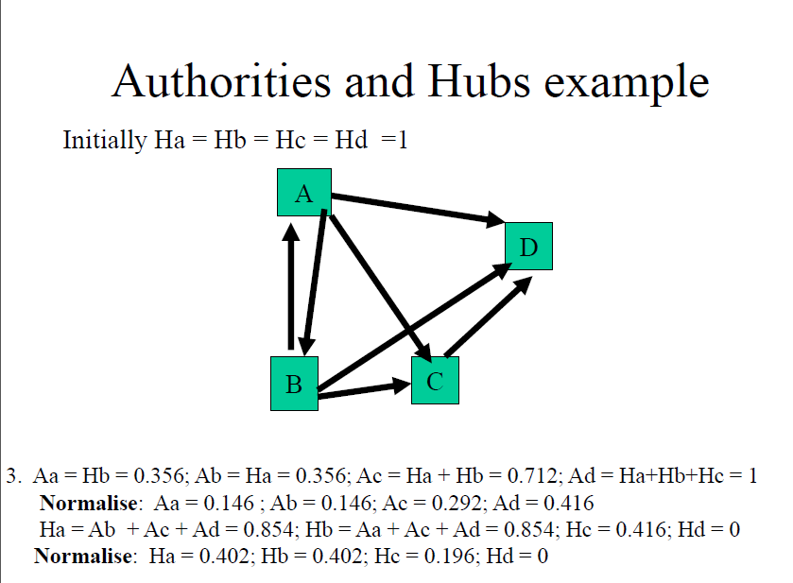
CS583, Bing Liu, UIC

Slide 11
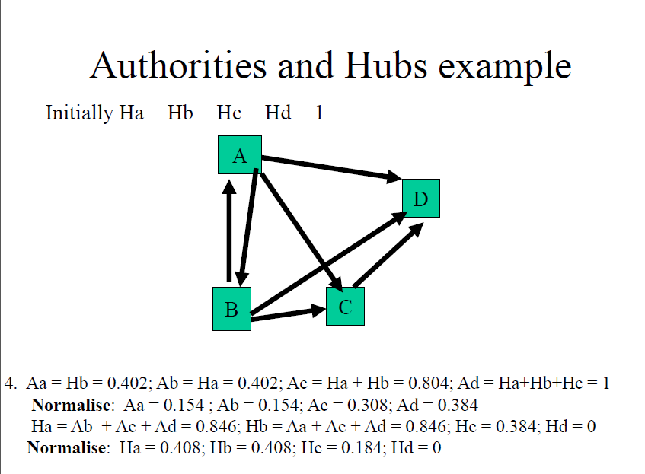
CS583, Bing Liu, UIC

Slide 12
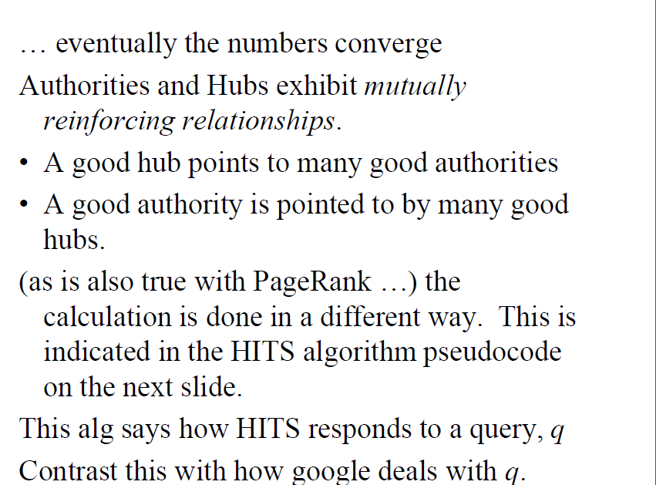
CS583, Bing Liu, UIC

Slide 13
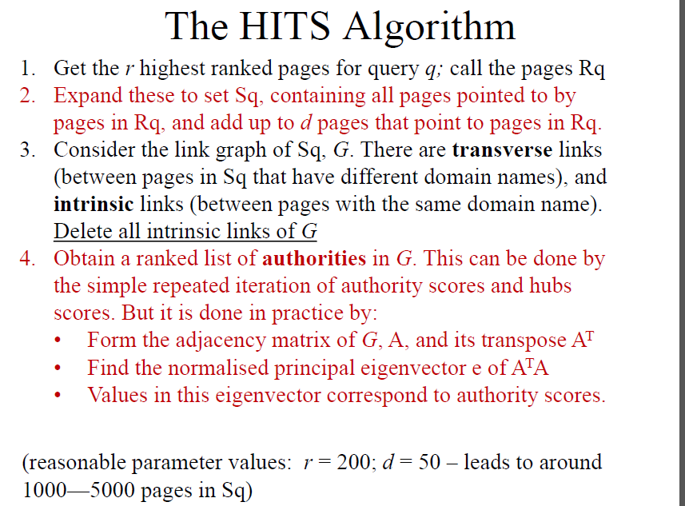
CS583, Bing Liu, UIC

